Slide 1
Research Question 3:
How do data science role salaries vary by role type? Out of all the Data Science Job Titles, which Job Title has the highest average salary?

Slide 2
How Many Job Tilte In Data Science?
There are 50+ job titles in Data Science.
A lot of job title is very unpopular.
Which one is the popular job title? Our research will focus on popular job title.

Slide 3
Which One Is The Popular Job Title?
We will draw a pie chart to present the popular. The pie chart is easy to read and understand.
But job title is too more, so we classified the unpopular job title as ‘Other’.
According to the data, we choosed top 14 job titles which they has more than 1%.

Slide 4
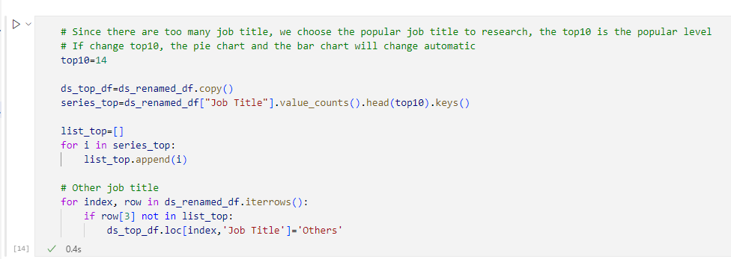
Classify The Unpopular Job Title As ‘Other’

Slide 5
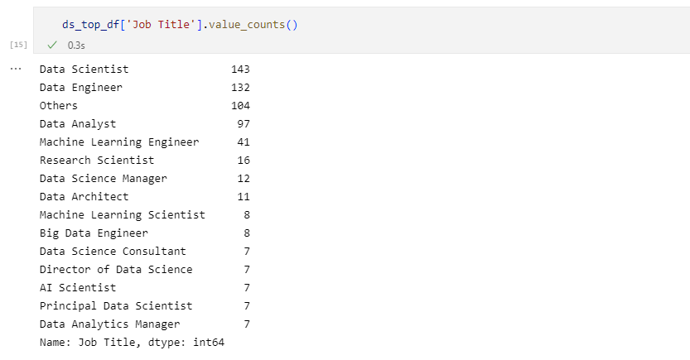
Result

Slide 6
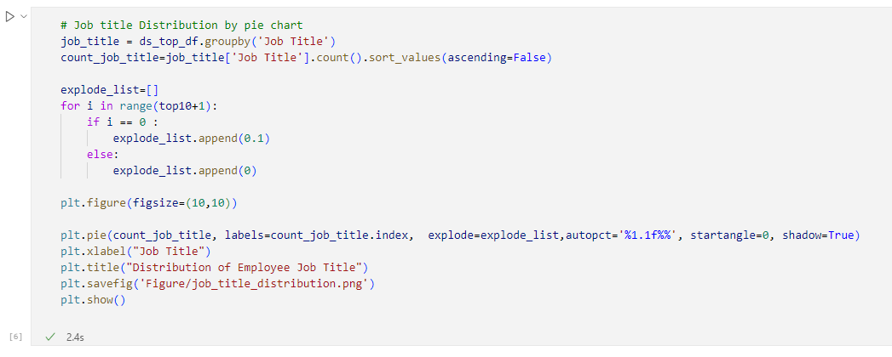
The Popular Job Title, Draw A Pie Chart

Slide 7
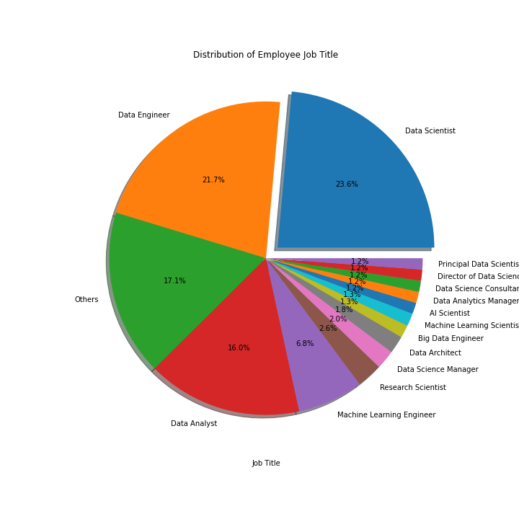
The Pie Chart of Popular Job Title

Slide 8
Major Findings 1
The most popular job title is 'Data Scientist, 23.6%, the second one is 'Data Engineer', 21.7%, the third one is 'Data Analyst', 16%.
The top three accounted for 61.3%.
The other for 17.1%, so the top 14 accounted for 82.9%.

Slide 9
Which Job Title Has The Highest Average Salary?
The high average salary will be reseach in popular job title. The rare one has few samples, make a average mean nothing.

Slide 10
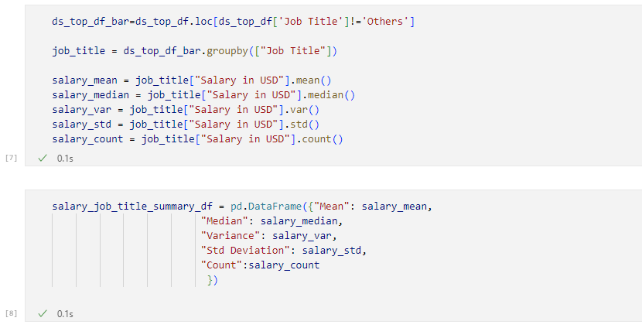
Group By Job Title, And Get Mean/Average

Slide 11
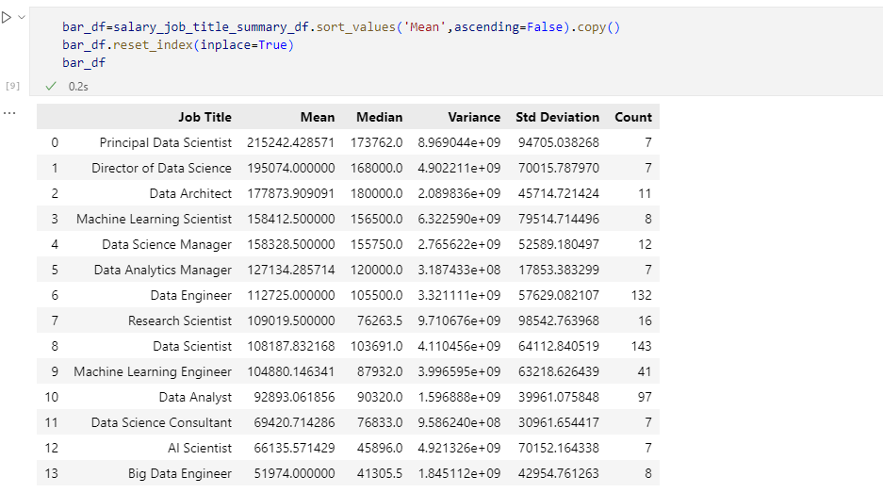
Prepare Data To Draw Bar chart

Slide 12
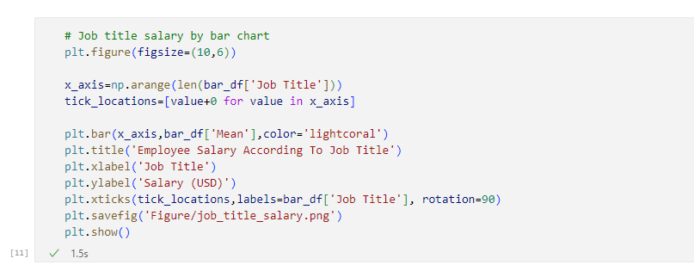
Draw A Bar Chart

Slide 13
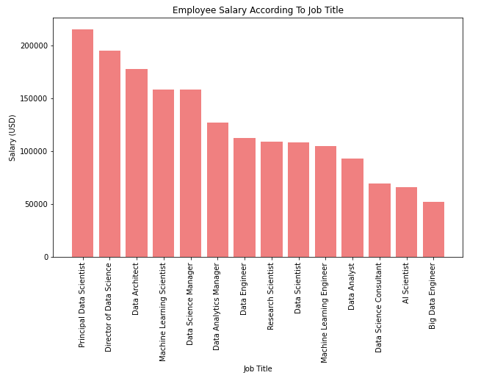
Employee Salary According To Job Title

Slide 14
Major Findings 2
The highest salary of job title is 'Principal Data Scientist’, the next one is 'Director of Data Science'.
Except for management position, the highest one is 'Data Architect’.
The 'Big Data Engineer' is not good for employee, this job title average salary is USD 52000, only half of 'Data Engineer'. 'Big' is less.

Slide 15
The End
Thanks for watching.

